Slide 1
!
How Will You Rise to the Occasion?

Slide 2
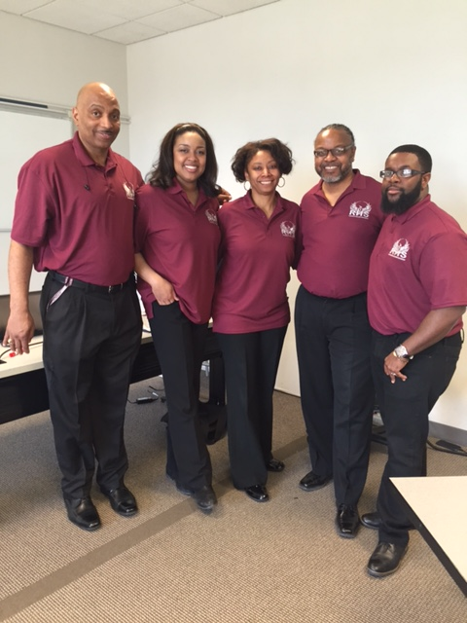
Renaissance High School Counseling Department
Last Names Counselor
A-F Mrs. Jones
G-L Mrs. Womble
M-R Mr. Duncan
S-Z Mr. Andrews
CTA Mr. Bracy
The Counseling Center is located on the 2nd floor, adjacent to the Main Office. Open during First & Second Lunch Periods (313) 416-4608 Counseling Main Line

Slide 3
What Does a School Counselor Do?

Slide 4
WHAT DO SCHOOL COUNSELORS DO?

Slide 5
What do Counselors do?
In-class presentations
Small group sessions and activities across the grade levels
Crisis intervention
Solution-focused individual counseling
Group counseling
Academic guidance and planning
Career development and planning
Standardized testing interpretation
Conflict mediation
Social and emotional counseling

Slide 6
What needs to be done before September 8
SENIORS
JUNIORS
Register for Parchment
Complete EDP
Register for the Detroit Scholarship Fund
Register for FAFSA
Register for Parchment
Complete EDP
Register for Parchment
Register for collegeboard.org for test prep and practice for the new SAT on Khan Academy®

Slide 7
What needs to be done before September 8
SOPHOMORES
FRESHMEN
Complete EDP
Email your counselor outlining your plan of action for the upcoming school year.
Evaluate your course load and find out how much you know about college planning.
Set an appointment to introduce yourself and discuss your career and college goals.
Familiarize yourself with the RHS curriculum
Think about which extracurricular activities you’re interested in andare willing to commit the time.
Capitalize on college planning resources and learn more about colleges and universities

Slide 8
Dates to remember
August 27th & 28th – Student Orientations
August 28- last day to email your counselor for a class change
September 8- First day of school
September 14- Counselors will begin college applications & Common Applications
September 16- Deadline for submission of letter of recommendation requests
September 23- Letters of recommendation passed out during senior conferences

Slide 9
www.rhscounselors.weebly.com

